Slide 1
Merge Sort

Slide 2
Divide and Conquer
Recursive is one type of divide-and-conquer approach.
Divide-and-conquer paradigm
Divide the problem into a number of subproblem that are smaller instances of the same problem.
Solve each subproblems recursively.
If the subproblems become small enough, solve them directly.
Combine the solutions to the subproblems into the solution for the original problem.

Slide 3
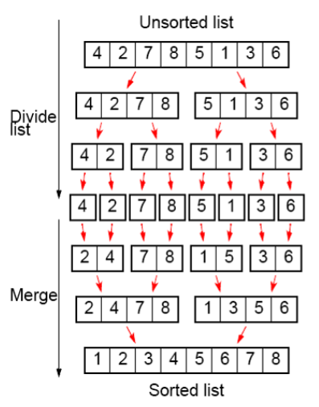
Merge Sort
Closely follow the divide-and-conquer paradigm.
Divide: Divide the n-element sequences to be sorted into subsequences of n/2 elements each.
Conquer: Sort the two subsequences recursively using merge sort.
Divide: Divide the n/2-element sequences to be sorted into subsequences of n/4 elements each.
Conquer: Sort the two subsequences recursively using merge sort.
…
Combine: Merge the two sorted subsequences to produce the sorted answer.
The recursion stops when the (sub)sequence to be sorted is of length 1.

Slide 4
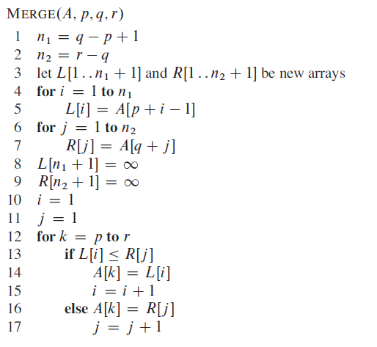
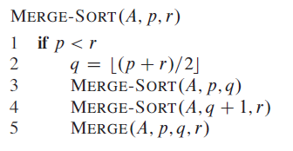
Merge Sort

Slide 5
MERGE-SORT(A, 1, 8)
14 | 23 | 5 | 67 | 1 | 54 | 121 | 8
MERGE-SORT(A, 1, 1)
14 | 23 | 5 | 67 | 1 | 54 | 121 | 8
MERGE-SORT(A, 1, 2)
MERGE-SORT(A, 2, 2)
14 | 23 | 5 | 67 | 1 | 54 | 121 | 8
14 | 23 | 5 | 67 | 1 | 54 | 121 | 8
MERGE-SORT(A, 1, 4)
14 | 23 | 5 | 67 | 1 | 54 | 121 | 8

Slide 6
MERGE-SORT(A, 1, 8)
14 | 23 | 5 | 67 | 1 | 54 | 121 | 8
MERGE-SORT(A, 1, 1)
MERGE(A, 1, 1, 2)
14 | 23 | 5 | 67 | 1 | 54 | 121 | 8
MERGE-SORT(A, 1, 2)
MERGE-SORT(A, 2, 2)
14 | 23 | 5 | 67 | 1 | 54 | 121 | 8
14 | 23 | 5 | 67 | 1 | 54 | 121 | 8
MERGE-SORT(A, 1, 4)
14 | 23 | 5 | 67 | 1 | 54 | 121 | 8

Slide 7
MERGE-SORT(A, 1, 8)
14 | 23 | 5 | 67 | 1 | 54 | 121 | 8
MERGE-SORT(A, 1, 2)
14 | 23 | 5 | 67 | 1 | 54 | 121 | 8
14 | 23 | 5 | 67 | 1 | 54 | 121 | 8
MERGE-SORT(A, 3, 4)
MERGE-SORT(A, 3, 3)
MERGE-SORT(A, 1, 4)
MERGE(A, 4, 4, 5)
14 | 23 | 5 | 67 | 1 | 54 | 121 | 8
14 | 23 | 5 | 67 | 1 | 54 | 121 | 8
MERGE-SORT(A, 4,4)
14 | 23 | 5 | 67 | 1 | 54 | 121 | 8

Slide 8
MERGE-SORT(A, 1, 8)
14 | 23 | 5 | 67 | 1 | 54 | 121 | 8
MERGE-SORT(A, 1, 2)
MERGE(A, 1, 2, 4)
5 | 14 | 23 | 67 | 1 | 54 | 121 | 8
MERGE-SORT(A, 3, 4)
MERGE-SORT(A, 1, 4)
14 | 23 | 5 | 67 | 1 | 54 | 121 | 8
5 | 14 | 23 | 67 | 1 | 54 | 121 | 8

Slide 9
MERGE-SORT(A, 1, 8)
5 | 14 | 23 | 67 | 1 | 54 | 121 | 8
MERGE-SORT(A, 1, 4)
5 | 14 | 23 | 67 | 1 | 54 | 121 | 8
MERGE-SORT(A, 5, 5)
14 | 23 | 5 | 67 | 1 | 54 | 121 | 8
5 | 14 | 23 | 67 | 1 | 54 | 121 | 8
MERGE-SORT(A, 5, 8)
MERGE-SORT(A, 5, 6)
MERGE-SORT(A, 6, 6)
5 | 14 | 23 | 67 | 1 | 54 | 121 | 8
5 | 14 | 23 | 67 | 1 | 54 | 121 | 8

Slide 10
MERGE-SORT(A, 1, 8)
5 | 14 | 23 | 67 | 1 | 54 | 121 | 8
MERGE-SORT(A, 1, 4)
5 | 14 | 23 | 67 | 1 | 54 | 121 | 8
MERGE-SORT(A, 5, 5)
14 | 23 | 5 | 67 | 1 | 54 | 121 | 8
5 | 14 | 23 | 67 | 1 | 54 | 121 | 8
MERGE(A, 5, 5, 6)
MERGE-SORT(A, 5, 8)
MERGE-SORT(A, 5, 6)
MERGE-SORT(A, 6, 6)
5 | 14 | 23 | 67 | 1 | 54 | 121 | 8
5 | 14 | 23 | 67 | 1 | 54 | 121 | 8

Slide 11
MERGE-SORT(A, 1, 8)
5 | 14 | 23 | 67 | 1 | 54 | 121 | 8
MERGE-SORT(A, 1, 4)
14 | 23 | 5 | 67 | 1 | 54 | 121 | 8
5 | 14 | 23 | 67 | 1 | 54 | 121 | 8
MERGE-SORT(A, 5, 8)
MERGE-SORT(A, 5, 6)
5 | 14 | 23 | 67 | 1 | 54 | 121 | 8
5 | 14 | 23 | 67 | 1 | 54 | 121 | 8
MERGE-SORT(A, 7, 8)
MERGE-SORT(A, 7, 7)
5 | 14 | 23 | 67 | 1 | 54 | 121 | 8
MERGE-SORT(A, 8, 8)
5 | 14 | 23 | 67 | 1 | 54 | 121 | 8

Slide 12
MERGE-SORT(A, 1, 8)
5 | 14 | 23 | 67 | 1 | 54 | 121 | 8
MERGE-SORT(A, 1, 4)
14 | 23 | 5 | 67 | 1 | 54 | 8 | 121
5 | 14 | 23 | 67 | 1 | 54 | 121 | 8
MERGE-SORT(A, 5, 8)
MERGE-SORT(A, 5, 6)
5 | 14 | 23 | 67 | 1 | 54 | 8 | 121
5 | 14 | 23 | 67 | 1 | 54 | 121 | 8
MERGE-SORT(A, 7, 8)
MERGE-SORT(A, 7, 7)
5 | 14 | 23 | 67 | 1 | 54 | 8 | 121
MERGE(A, 7, 7, 8)
MERGE-SORT(A, 8, 8)
5 | 14 | 23 | 67 | 1 | 54 | 121 | 8

Slide 13
MERGE-SORT(A, 1, 8)
5 | 14 | 23 | 67 | 1 | 54 | 121 | 8
MERGE-SORT(A, 1, 4)
14 | 23 | 5 | 67 | 1 | 8 | 54 | 121
5 | 14 | 23 | 67 | 1 | 54 | 121 | 8
MERGE-SORT(A, 5, 8)
MERGE-SORT(A, 5, 6)
5 | 14 | 23 | 67 | 1 | 8 | 54 | 121
MERGE(A, 5, 6, 8)
MERGE-SORT(A, 7, 8)
5 | 14 | 23 | 67 | 1 | 54 | 8 | 121

Slide 14
MERGE-SORT(A, 1, 8)
5 | 14 | 23 | 67 | 1 | 54 | 121 | 8
MERGE-SORT(A, 1, 4)
1 | 5 | 8 | 14 | 23 | 54 | 67 | 121
MERGE(A, 1, 4, 8)
MERGE-SORT(A, 5, 8)
5 | 14 | 23 | 67 | 1 | 8 | 54 | 121

Slide 15
Merge example
k | i | j | L[i] | R[j] | L[i] <= R[j] | A[k]
1 | 1 | 1 | 5 | 1 | FALSE | 1
2 | 1 | 2 | 5 | 8 | TRUE | 5
3 | 2 | 2 | 14 | 8 | FALSE | 8
4 | 2 | 3 | 14 | 54 | TRUE | 14
5 | 3 | 3 | 23 | 54 | TRUE | 23
6 | 4 | 3 | 67 | 54 | FALSE | 54
7 | 4 | 4 | 67 | 121 | TRUE | 67
8 | 5 | 4 | max_inf | 121 | FALSE | 121
i | 1 | 2 | 3 | 4 | 6
L | 5 | 14 | 23 | 67 | max_inf
j | 1 | 2 | 3 | 4 | 6
R | 1 | 8 | 54 | 121 | max_inf
k | 1 | 2 | 3 | 4 | 5 | 6 | 7 | 8
A

Slide 16

Runtime of MergeSort
We will revisit the proof for this equation later in the semester.

Slide 17
Java Implementation
https://github.com/linhbngo/algorithms/blob/master/Sort/MergeSort.java
Compile and test in your Atom environment.

Slide 18
Leetcode
Adapt the MergeSort algorithm to solve the following problem: https://leetcode.com/problems/sort-an-array
What is your performance relative to other submissions using InsertionSort and ShellSort?

